Slide 1


Welcome to
Nhóm II
Member:
Nguyễn Văn Thuyên
Tăng Thế Mạnh
Phạm Văn Dũng
Đinh Văn Thức
Phạm Tiến Thành Công
Link video thuyết trình:
https://www.youtube.com/watch?v=JOmmXyGZPlU

Slide 2
general introduction
1. What is an operating system?
An operating system is a program that acts as an intermediary between the user and the computer hardware.The operating system hides the complexity, variety of hardware, and makes using the computer simple and efficient.
2. OS tasks
The operating system's job is to manage computer resources, execute application programs, and support network functions…

Slide 3
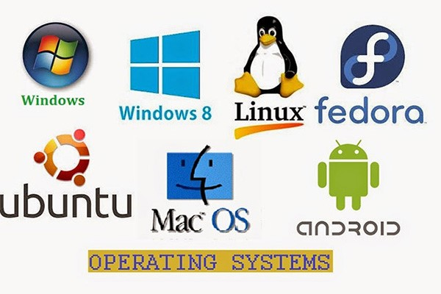
3.Some examples of operating systems:

Slide 4

3.Some contents of the operating system course:
Virtualization
Processes
ProcessAPI
Direct excution
CPU schedling
Milti-level feedback
Lottery Scheduling
Multi-CPU…

Slide 5

Concurrency:
Concurrency and threads
Dialogue
Thread API
Locks
Locked data structures
Persistence:
Dialogue
I/O Devices
Hard Disk Drives
Redundant Disk Arrays (RAID)
Files and Directories

Slide 6

Security:
Dialogue
Intro Security
Authentication
Access Control
Cryptography

Slide 7

II Content
CPU scheduling

Slide 8
What is CPU scheduling in Operating System?
CPU scheduling is a process that allows one process to use the CPU while the execution of another process is on hold due to unavailability of any resource like I/O etc, thereby making full use of CPU.

Slide 9
Purpose of CPU scheduling?
The purpose of CPU scheduling is to make the system work efficiently, quickly and fairly
gì ?

Slide 10
CPU Scheduling: Dispatcher
Another component involved in the CPU scheduling function is the Dispatcher.
So what is the Dispatcher?
The dispatcher is the module that gives control of the CPU to the process selected by the short-term scheduler

Slide 11
function of the Dispatcher
-Switching context
-Switching to user mode
-Jumping to the proper location in the user program to restart that program from where it left last time.

Slide 12
Types of CPU Scheduling CPU scheduling decisions may take place under the following four circumstances: 1. When a process switches from the running state to the waiting state 2. When a process switches from the running state to the ready state 3. When a process switches from the waiting state to the ready state 4. When a process terminates. Bouns: 1 and 4 is the non-priority scheduling 2 and 3 is the preemptive.

Slide 13
Non-Preemptive Scheduling
Under non-preemptive scheduling, once the CPU has been allocated to a process, the process keeps the CPU until it releases the CPU either by terminating or by switching to the waiting state

Slide 14
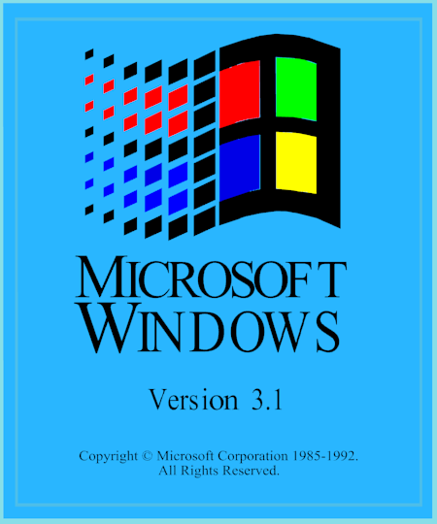

non-preemptive scheduling example
Microsoft Windows 3.1 Apple Macintosh

Slide 15
Preemptive Scheduling
In this type of Scheduling, the tasks are usually assigned with priorities. At times it is necessary to run a certain task that has a higher priority before another task although it is running. Therefore, the running task is interrupted for some time and resumed later when the priority task has finished its execution.

Slide 16
CPU Scheduling
CPU Scheduling Criteria

Slide 17
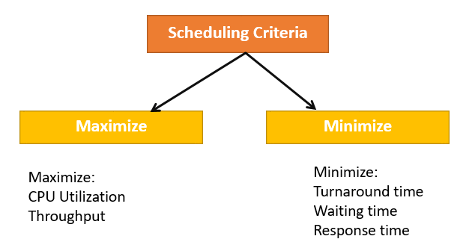
CPU Scheduling
II. CPU Scheduling Criteria
- A CPU scheduling algorithm tries to maximize and minimize the following:

Slide 18
CPU Scheduling
II. CPU Scheduling Criteria
- What types of maximization?
- CPU utilization: CPU utilization is the main task in which the operating system needs to make sure that CPU remains as busy as possible. It can range from 0 to 100 percent. However, for the RTOS, it can be range from 40 percent for low-level and 90 percent for the high-level system.
- Throughput: The number of processes that finish their execution per unit time is known Throughput. So, when the CPU is busy executing the process, at that time, work is being done, and the work completed per unit time is called Throughput.

Slide 19
CPU Scheduling
II. CPU Scheduling Criteria
- What types of Minimize ?
Waiting time: is the specific amount of time that needs to be available in the queue, to be ready to be controlled and used on the CPU.
Response time: is the time from the time the request is sent, until the response is met. Attention: this is the time until the start of the process, not the time. complete progress
Turnaround time: is the time it takes for it to execute a particular process, that is, the time from submitting the process to the time it completes the process.
=> In general CPU utilization and Throughput are maximized and other factors are reduced for proper optimization.

Slide 20
CPU Scheduling
II. CPU Scheduling Criteria
- What is Interval Timer?
Timer interruption is a method that is closely related to preemption
When a certain process gets the CPU allocation, a timer may be set to a specified interval. Both timer interruption and preemption force a process to return the CPU before its CPU burst is complete.
=> Most of the multi-programmed operating system uses some form of a timer to prevent a process from tying up the system forever.

Slide 21
CPU Scheduling
II. CPU Scheduling Criteria
What is Dispatcher?
It is a module that provides control of the CPU to the process.
The Dispatcher should be fast so that it can run on every context switch. Dispatch latency is the amount of time needed by the CPU scheduler to stop one process and start another.
Functions performed by Dispatcher:
+ Context Switching
+Switching to user mode
+Moving to the correct location in the newly loaded program.

Slide 22
CPU Scheduling
Scheduling algorithm

Slide 23
CPU Scheduling
III. Scheduling Algorithm
- The Purpose of a Scheduling algorithm ?
The CPU uses scheduling to improve its efficiency.
It helps you to allocate resources among competing processes.
The maximum utilization of CPU can be obtained with multi-programming.
The processes which are to be executed are in ready queue.

Slide 24
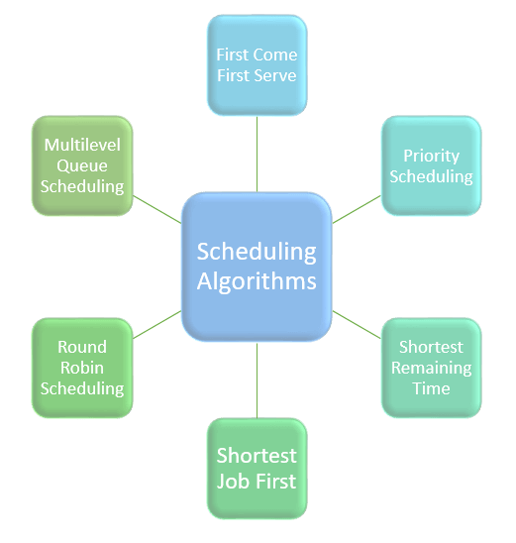
CPU Scheduling
III. Scheduling Algorithm
- What types of Scheduling Algorithm?
First Come First Serve (FCFS)
Shortest-Job-First (SJF) Scheduling
Shortest Remaining Time
Priority Scheduling
Round Robin Scheduling
Multilevel Queue Scheduling

Slide 25
CPU Scheduling
III. Scheduling Algorithm
1. First Come First Serve (FCFS)
Concept:
Scheduling algorithm "First come first serve". Like the name, this algorithm requires: the process that comes first will execute first, the process that comes later will execute later.
First come first serve, it is the same as the data structure: Queue.
A practical example of the First come first serve algorithm is buying tickets at a ticket counter.

Slide 26
CPU Scheduling
III. Scheduling Algorithm
1. First Come First Serve (FCFS)
Problem:
The Non Pre-emptive algorithm or the priority algorithm will not be used, the priority of the process is no longer important.
That's why the system will easily crash, just because of improper process planning
Non-optimal average time
Parallel resource usage is not possible. This will result in the “Convoy” effect. As a result, resource usage (CPU, I/O, etc.) is poor.

Slide 27
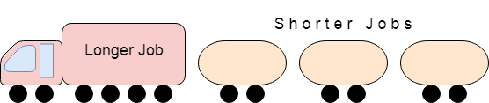
CPU Scheduling
III. Scheduling Algorithm
1. First Come First Serve (FCFS)
What is the Convoy Effect???:
The Convoy effect occurs when there are many processes going on, and it needs to use a resource for a short time but is blocked by a process holding that resource for a long time!
This leads to high resource usage and poor performance

Slide 28
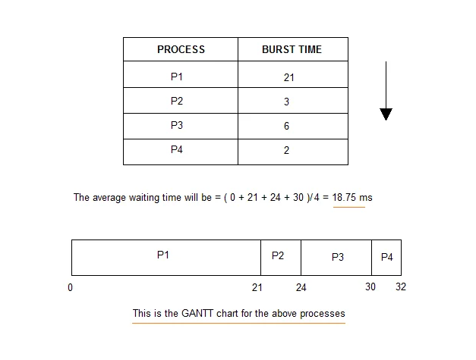
CPU Scheduling
III. Scheduling Algorithm
1. First Come First Serve (FCFS)
Illustration diagram:

Slide 29
CPU Scheduling
III. Scheduling Algorithm
2. Shortest-Job-First (SJF) Scheduling
Characteristics:
It works on the principle that the shortest time or interval will run first.
Will minimize waiting time.
Use in series welding system
For successful execution, the processor must know the execution time of the processes in advance. Therefore, this is actually quite unrealistic.
This scheduling algorithm is optimal if all processes are ready to execute at the same time.

Slide 30
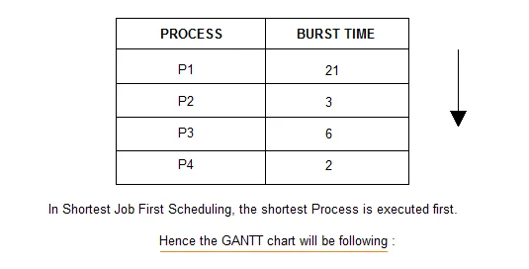
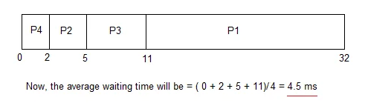
CPU Scheduling
III. Scheduling Algorithm
2. Shortest-Job-First (SJF) Scheduling
Illustration diagram :

Slide 31
CPU Scheduling
III. Scheduling Algorithm
2. Shortest-Job-First (SJF) Scheduling
The Problem of Shortest-Job-First with Non Pre-emptive :
When the readiness times of the processes are different, or the processes are not available in the queue at time 0. In such situations, sometimes the new processes have a short time Wait for the execution to finish. Because in SJF there is no priority when a new process occurs,
Therefore, it leads to a lack of resources, and a shorter process has to wait for a longer process to execute

Slide 32
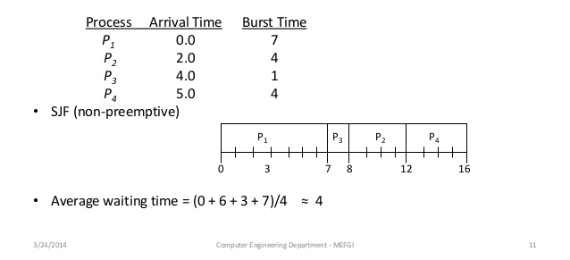
CPU Scheduling
III. Scheduling Algorithm
2. Shortest-Job-First (SJF) Scheduling
The Problem of Shortest-Job-First with Non Pre-emptive :

Slide 33
CPU Scheduling
III. Scheduling Algorithm
3. Shortest Remaining Time
Concept:
In this method the processes will be sorted so that the processes that are about to complete will be deployed first and the processes that are not running will be deployed later. This will prevent new processes from executing and it will execute older processes
Characteristics
This method is mostly applied in a royal environment where short-term work is prioritized
This is not an ideal method to implement it in a shared system, where the CPU time required is unknown.
- However, this is an algorithm that helps to schedule with the shortest time possible.

Slide 34
CPU Scheduling
III. Scheduling Algorithm
4. Priority Scheduling
Concept:
This is a priority-based scheduling method. The scheduler then chooses the tasks and processes to work on by priority
So jobs with higher priority will be executed sooner. And jobs of equal priority will be executed under Round-Robin or First Come First Serve.

Slide 35
CPU Scheduling
III. Scheduling Algorithm
5. Round-Robin Scheduling.
Concept:
Round Robin scheduling algorithm is mainly designed for time sharing systems.
This algorithm is similar to FCFS but in Round Robin scheduling algorithm the priority will be added
This algorithm will overcome the Convoy situation in real FCFS math. Because shutting down all processes gives them a fair share of CPU.

Slide 36
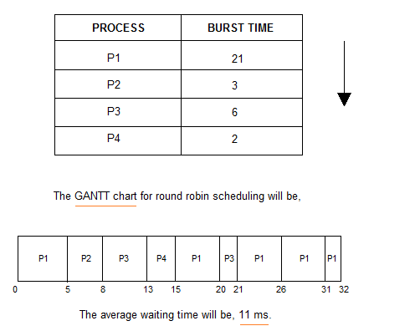
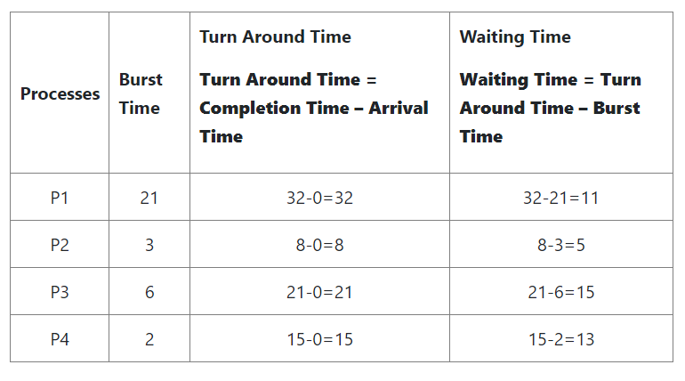
CPU Scheduling
III. Scheduling Algorithm
5. Round-Robin Scheduling.
Illustration diagram :

Slide 37
CPU Scheduling
III. Scheduling Algorithm
5. Round-Robin Scheduling.
Some advantages and Defect :
Advantages:
About the average response time this algorithm gives the best performance
Work will be properly allocated by CPU- Handle all processes without any prioritization.
Each process will have a chance to reschedule after a specific time.
Defect:
Algorithms spend a lot of time switching between processes and planning
Provides great response time and response

Slide 38
CPU Scheduling
III. Scheduling Algorithm
6. Multilevel Queue Scheduling
Concept:
This algorithm, it will split the ready queue into many different separate queues. Processes assign to a queue based on a process-specific property, such as: priority, memory size, etc.
However, this is not an independent scheduling algorithm, it needs to use other algorithms to schedule jobs.

Slide 39
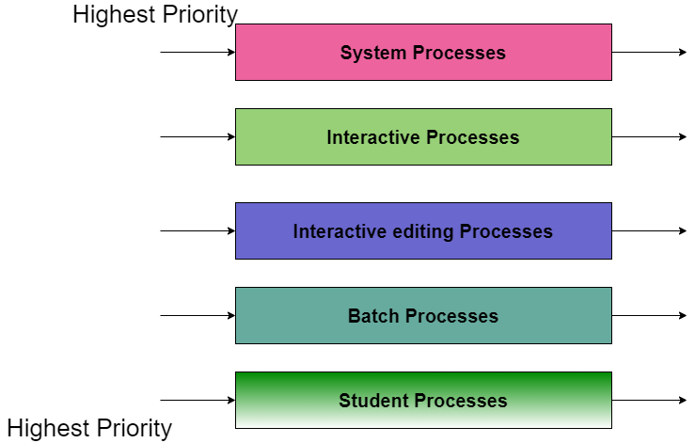
CPU Scheduling
III. Scheduling Algorithm
6. Multilevel Queue Scheduling
Illustration diagram:
For System Processes: First Come First Serve(FCFS) Scheduling.
For Interactive Processes: Shortest Job First (SJF) Scheduling.
For Interactive editing Processes: Shortest Job First (SJF) Scheduling.
For Batch Processes: Round Robin(RR) Scheduling
For Student Processes: Priority Scheduling

Slide 40
CPU Scheduling
III. Scheduling Algorithm
6. Multilevel Queue Scheduling
Some advantages and Defect :
Advantages:
We can apply many different types of scheduling algorithms
Defect:
It will cause low-level processes to not execute or, if present, to wait for a long time(Convoy).

Slide 41
CPU Scheduling
Thanks for listening
SV: Phạm Tiến Thành Công
MSSV: 20010886

Slide 42
Multilevel Feedback Queue Scheduling

Slide 43
General introduction
In a multilevel queue-scheduling algorithm, processes are permanently assigned to a queue on entry to the system. Processes do not move between queues. This setup has the advantage of low scheduling overhead, but the disadvantage of being inflexible.

Slide 44
But
Multilevel feedback queue scheduling, however, allows a process to move between queues. The idea is to separate processes with different CPU-burst characteristics. If a process uses too much CPU time, it will be moved to a lower-priority queue. Similarly, a process that waits too long in a lower-priority queue may be moved to a higher-priority queue. This form of aging prevents starvation.

Slide 45
In general, a multilevel feedback queue scheduler is defined by the following parameters:
The number of queues.
The scheduling algorithm for each queue.
The method used to determine when to upgrade a process to a higher-priority queue.
The method used to determine when to demote a process to a lower-priority queue.
The method used to determine which queue a process will enter when that process needs service.

Slide 46
The definition
The definition of a multilevel feedback queue scheduler makes it the most general CPU-scheduling algorithm. It can be configured to match a specific system under design. Unfortunately, it also requires some means of selecting values for all the parameters to define the best scheduler. Although a multilevel feedback queue is the most general scheme, it is also the most complex.

Slide 47
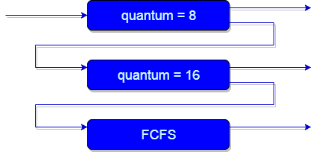
Example
First of all, Suppose that queues 1 and 2 follow round robin with time quantum 8 and 16 respectively and queue 3 follows FCFS. One of the implementations of Multilevel Feedback Queue Scheduling is as follows:

Slide 48
If any process starts executing then firstly it enters queue 1.
In queue 1, the process executes for 8 unit and if it completes in these 8 units or it gives CPU for I/O operation in these 8 units unit than the priority of this process does not change, and if for some reasons it again comes in the ready queue than it again starts its execution in the Queue 1.
If a process that is in queue 1 does not complete in 8 units then its priority gets reduced and it gets shifted to queue 2.

Slide 49
Above points 2 and 3 are also true for processes in queue 2 but the time quantum is 16 units. Generally, if any process does not complete in a given time quantum then it gets shifted to the lower priority queue.
After that in the last queue, all processes are scheduled in an FCFS manner.
It is important to note that a process that is in a lower priority queue can only execute only when the higher priority queues are empty.
Any running process in the lower priority queue can be interrupted by a process arriving in the higher priority queue.

Slide 50
The need for Multilevel Feedback Queue Scheduling(MFQS)
Following are some points to understand the need for such complex scheduling:
This scheduling is more flexible than Multilevel queue scheduling.
This algorithm helps in reducing the response time.

Slide 51
In order to optimize the turnaround time, the SJF algorithm is needed which basically requires the running time of processes in order to schedule them. As we know that the running time of processes is not known in advance. Also, this scheduling mainly runs a process for a time quantum and after that, it can change the priority of the process if the process is long. Thus this scheduling algorithm mainly learns from the past behavior of the processes and then it can predict the future behavior of the processes. In this way, MFQS tries to run a shorter process first which in return leads to optimize the turnaround time.

Slide 52
Advantages of MFQS
This is a flexible Scheduling Algorithm
This scheduling algorithm allows different processes to move between different queues.
In this algorithm, A process that waits too long in a lower priority queue may be moved to a higher priority queue which helps in preventing starvation.

Slide 53
Disadvantages of MFQS
This algorithm is too complex.
As processes are moving around different queues which leads to the production of more CPU overheads.
In order to select the best scheduler this algorithm requires some other means to select the values.

Slide 54
Lottery Scheduling

Slide 55
Proportional Share
Proportional-share is based around a simple concept: instead of optimizing for turnaround or response time, a scheduler might instead try to guarantee that each job obtain a certain percentage of CPU time.
The basic idea is quite simple: every so often, hold a lottery to determine which process should get to run next; processes that should run more often should be given more chances to win the lottery.

Slide 56
HOW TO SHARE THE CPU PROPORTIONALLY
In more detail:
How can we design a scheduler to share the CPU in a proportional manner?
What are the key mechanisms for doing so?
How effective are they?

Slide 57
Basic Concept: Tickets Represent Your Share
Underlying lottery scheduling is one very basic concept: tickets , which are used to represent the share of a resource that a process should receive. The percent of tickets that a process has represents its share of the system resource in question.
Example, suppose we have two processes, A and B, and further that A has 75 tickets while B has only 25. Thus, what we would like is for A to receive 75% of the CPU and B the remaining 25%.

Slide 58
Lottery Scheduling (Probabilistic)
Lottery scheduling achieves this probabilistically (but not deterministically) by holding a lottery every so often (say, every time slice). Holding a lottery is straightforward: the scheduler must know how many total tickets there are (in our example, there are 100). The scheduler then picks a winning ticket, which is a number from 0 to 99.

Slide 59
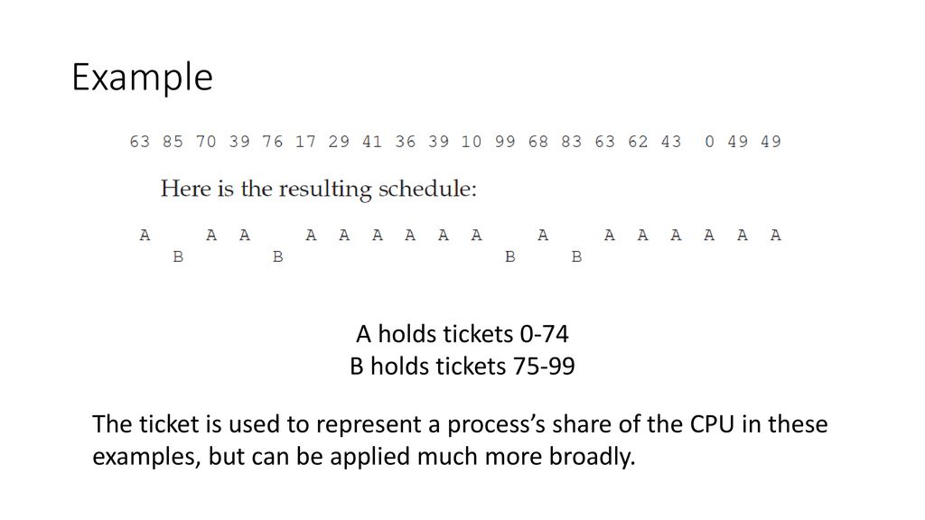
Following are some points to understand the need for such complex scheduling:
This scheduling is more flexible than Multilevel queue scheduling.
This algorithm helps in reducing the response time.

Slide 60
Implementation
Requires a random number generator
Linked list to keep track of job performance
Total number of tickets

Slide 61
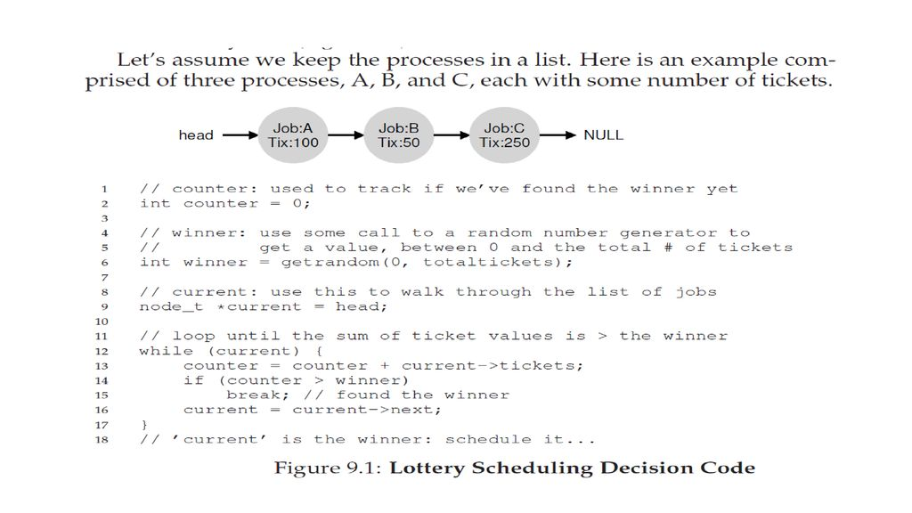

Slide 62
To make a scheduling decision, we first have to pick a random number (the winner) from the total number of tickets Let’s say we pick the number 300. Then, we simply traverse the list, with a simple counter used to help us find the winner (Figure 9.1).
The code walks the list of processes, adding each ticket value to counter until the value exceeds winner. Once that is the case, the current list element is the winner.
With our example of the winning ticket being 300, the following takes place. First, counter is incremented to 100 to account for A’s tickets; because 100 is less than 300, the loop continues. Then counter would be updated to 150 (B’s tickets), still less than 300 and thus again we continue. Finally, counter is updated to 400 (clearly greater than 300), and thus we break out of the loop with current pointing at C (the winner).
To make this process most efficient, it might generally be best to organize the list in sorted order, from the highest number of tickets to the lowest.

Slide 63
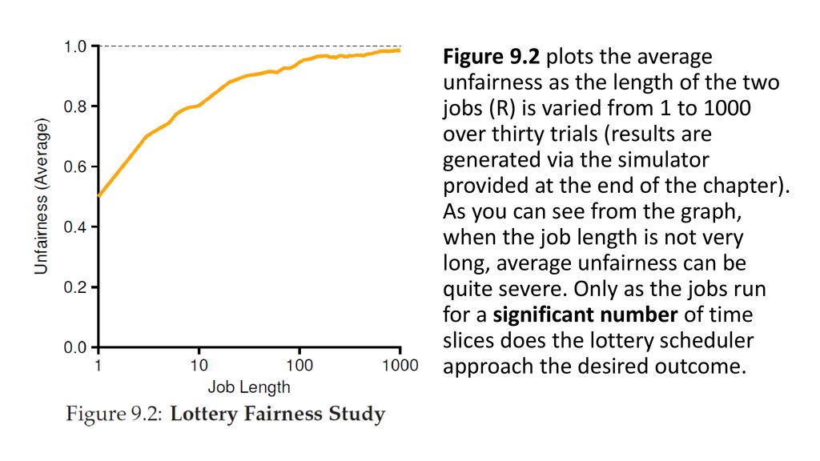

Slide 64
Stride scheduling, a deterministic fair-share scheduler
Stride scheduling is also straightforward. Each job in the system has a stride, which is Inverse in proportion to the number of tickets it has.
Suppose jobs A, B, and C, with 100, 50, and 250 tickets, respectively, we can compute the stride of each by dividing some large number by the number of tickets each process has been assigned. For example, if we divide 10,000 by each of those ticket values, we obtain the following stride values for A, B, and C: 100, 200, and 40. We call this value the stride of each process; every time a process runs, we will increment a counter for it (called its pass value) by its stride to track its global progress..

Slide 65
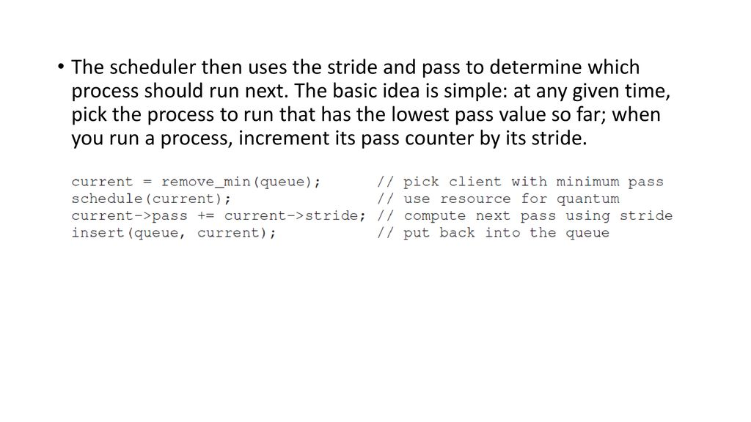

Slide 66
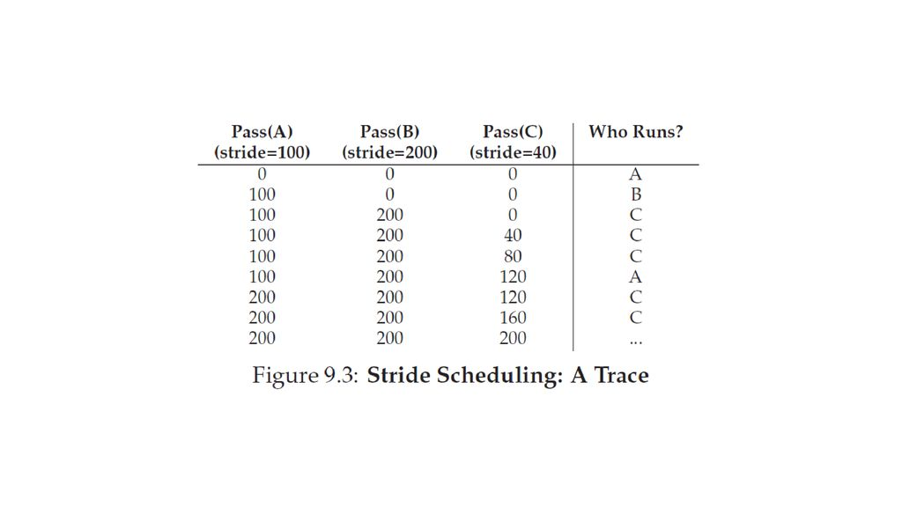

Slide 67

Thank you
teacher and friends for listening!!!

